Slide 1


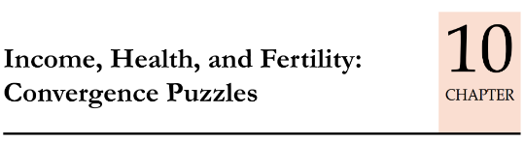
UNDP HDR-2016: 5 indexes
HDI: 131/188
HDI-inequality adj. (IHDI)
Gender Dev. (GDI)
Poverty Multidim. (MPI)
Gender Inequality (GII) 125/159
Health, Education, PH, Tribal related
rank: 97/151
27% loss to HDI by inequality
Female/Male HDI
=group 1 to 5
India in 5th group [most bogus gr.]
This is the last video in the BES17 series.
Schemes for Women
Poverty, Hunger schemes
Notes:
Human Development Index (HDI)
the Inequality-Adjusted Human Development Index (IHDI)
Gender Development Index (GDI)
Gender Inequality Index (GII)
Multidimensional Poverty Index (MPI)

Slide 2
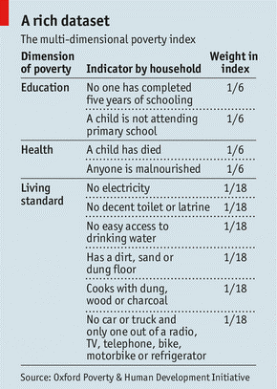
UNDP Index #5: Multidimensional Poverty Index (MPI), since 2010
MPI (3d)
Education-2
Health-2
Std of Living-6
How many of these 10 indicators
does your household lack?

Slide 3
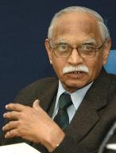

Poverty Lines and Figures for Indian Population!
so it means by Giving UBI, Arvind can take poors out of my definition but not of UNDP’s! [-Suresh Tendulkar]
Poverty =!$+!social justice+ !gender justice + !good governance
Expenditure method
Per month per person (2011)
1000 (U)
816 (R)
Income method, per person per day
< $1.90 (PPP)
Household
Deprivation
3 dimensions x
10 indicators
Notes:
www.marketwatch.com/story/a-new-way-to-help-the-900-million-people-who-earn-less-than-190-a-day-2016-04-11
https://books.google.co.in/books?id=Us65DQAAQBAJ&pg=PT582&lpg=PT582&dq=world+bank+poverty+line+earning+income+less+than+$1.90&source=bl&ots=HSRoB4CKDs&sig=FKD6pmtFLsmBDxCeQI77OFf3xqo&hl=en&sa=X&ved=0ahUKEwivpd6tjLPUAhWHqo8KHdZiBaE4FBDoAQg7MAU

Slide 4
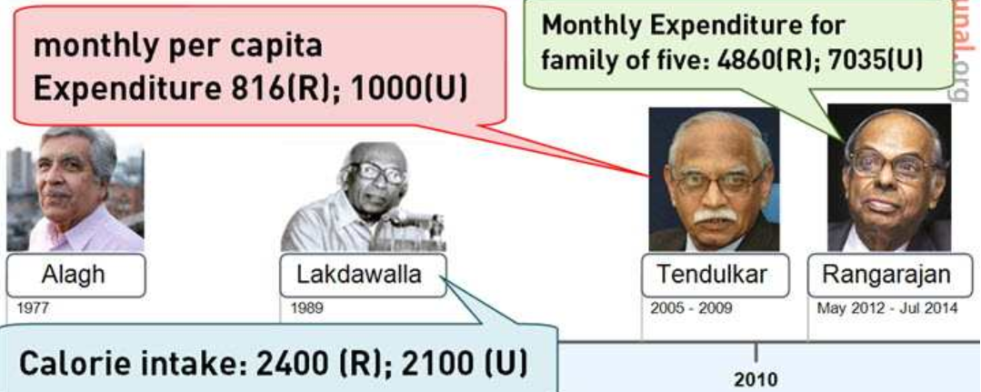
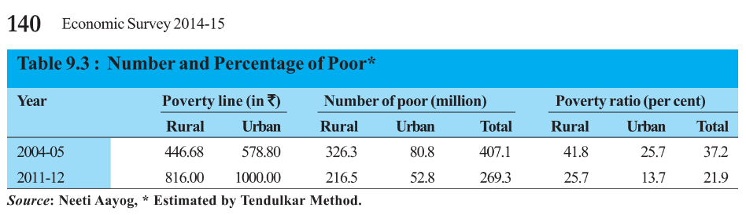
Poverty estimation & scheme entitlements in India
Per day Rs 33!
Consumption Expenditure
Calorie (Alagh)
Clothing
Shelter
Per day Rs 47!
But Economies of scale:
5 house x 1 tea x LPG
> [1 house x 5 tea x LPG]
27 cr.
22%
@CEA, spelling mistake in your 2014 survey
Notes:
Starvation

Slide 5
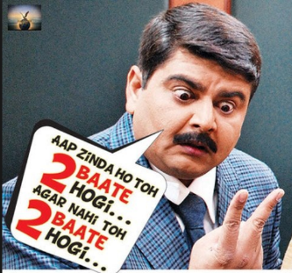
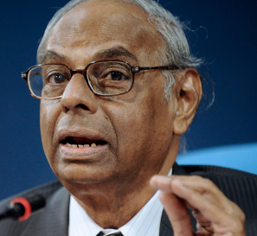
If you’re spending daily “x” of rupees or eating “y” amt of calories then you’re not poor. And we’ll not give you Government scheme benefits!
Else below poverty line. Hence eligible for Government schemes & entitlements.
Indian poverty estimation methods so far….
C. Rangarajan Committee
This consumption based ‘cutoff’ system is not the proper way: 2399 cal. = poor | 2400 = not poor, So we’ll not give scheme benefit!
We should look at overall deprivation of household, and give them scheme benefits!

Slide 6
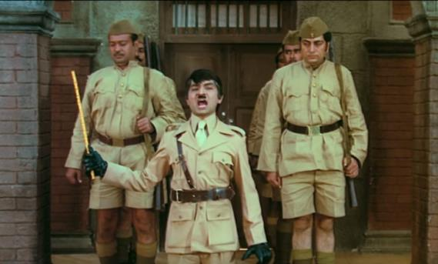
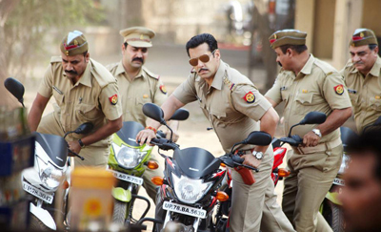
Concept of Socio Economic Caste Census (SECC-2011)

Slide 7
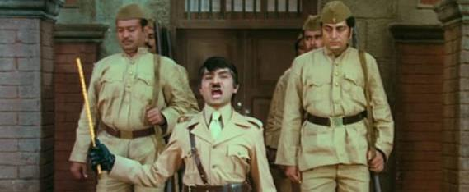
SECC: not poverty line but quantum of deprivation: to help BPL list preparation, and entitlement (DATA is rural household%)
Automatically excluded
7-Deprivation indicators
Automatically included
Households without shelter
Destitute/living on alms
Manual scavengers
Primitive Tribal Groups
Legally released bonded labourers
Paying direct taxes
Owning irrigated land, house/vehicle, fridge, landline
>10k/month
Government job…
1. Nature of house
2. Adult members?
3. Any literate adult?
4. Female head?
5. Only PH?
6. SC/ST?
7. Landless household?
~0.92%
Being used in
NFSA
PMAY_G (House)
PM Ujjwala (LPG)
Future planned (2017 Apr)
NSoAP (pension)
NRLM (SHG, skill, credit)
MNREGA (all rural households guaranteed by act)
~40%
Notes:
http://www.financialexpress.com/india-news/government-to-use-secc-2011-census-data-to-identify-beneficiaries/614972/

Slide 8
Mock Question for Prelims
Which of the following aim to use SECC-2011 census data for the identification of beneficiaries?
PM Awas Yojana Gramin
National Food security Act
PM Ujjwala Yojana
Answer choices:
a) Only 1 and 2 (b) Only 2 and 3
c) Only 1 and 3 (d) all of them

Slide 9

SECC-2011: 1st time since 1931, Nodal Ministry: MoRD.
in Rural
MoRD
Saxena Committee
in Urban
MoHUPA
Hashim Committee
Caste Census (MHA)
Registrar General
Census Commissioner
Not released else demand for inclusion / exclusion of xyz caste?
Not yet released as per website?
Released (Jul.15)
Notes:
www.dnaindia.com/india/report-secc-reveals-two-indias-but-government-refuses-to-disclose-caste-data-2101599

Slide 10
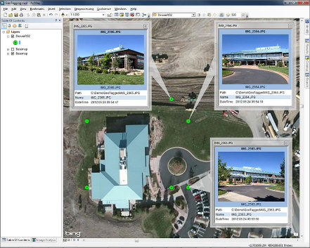
What about unskilled Poor? Rural Dev Ministry: MNREGA
Act?
Funding
Min. 100 days unskilled manual work to every rural household.
2009: "M" added. (why not MGNREGA!!)
2005: National Rural Employment Guarantee Act
What?
Core of the core scheme. Union bears 100% unskilled laborer’s wages, 75% material, 6% admin
Budget 2017: 48k crores
ICT, E-Governance?
NREGASoft , DBT
Budget 2017: Geotagging of all assets

Slide 11
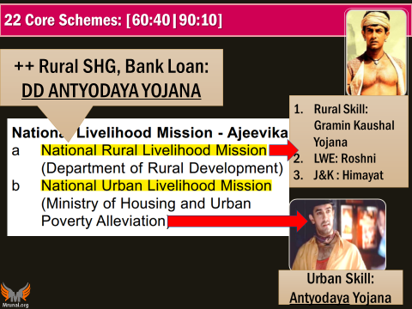
Poverty Removal by Rural development Ministry?
1999
Swarnajayanti Gram Swarojgar Yojana [before that IRDP]
2010
National Rural Livelihood Mission “Aajeevika”
25th Dec= Antyodaya Diwas; Modi = Good Governance day : Vajpayee b’day
Modi Core Schemes
National Livelihood “Aajeevika”
Urban
Rural
Other skilling schemes: <BES174>

Slide 12
Poverty
Mission “Antyodaya”: 50k GP poverty free by 2019 (i.e. 150th Anniversary of Gandhi)
Every year >3 lakh cr. Spent on rural areas, then why poverty not ▼? ☹
Composite poverty index for GP- for accountability and monitoring.
Budget 2017

Slide 13
Mock question for prelims
By Gandhi’s 150th Birth anniversary, which of the following target(s) does the Government of India aim to achieve?
Housing for all
Doubling the income of farmers.
Open defecation free India.
50,000 Gram Panachayats declared Poverty free.
Answer choices
(a) 3 only
(b) 2 and 3 only
(c) 1 and 3 only
(d) 1, 2, 3 and 4

Slide 14
UNDP HDR-2016: 5 indexes
HDI: 131/188
HDI-inequality adj. (IHDI)
Gender Dev. (GDI)
Poverty Multidim. (MPI)
Gender Inequality (GII) 125/159
Health, Education, PH, Tribal related
rank: 97/151
27% loss to HDI by inequality
Female/Male HDI
=group 1 to 5
India in 5th group [most bogus gr.]
Schemes for Women
Poverty, Hunger games schemes
Notes:
Human Development Index (HDI)
the Inequality-Adjusted Human Development Index (IHDI)
Gender Development Index (GDI)
Gender Inequality Index (GII)
Multidimensional Poverty Index (MPI)

Slide 15
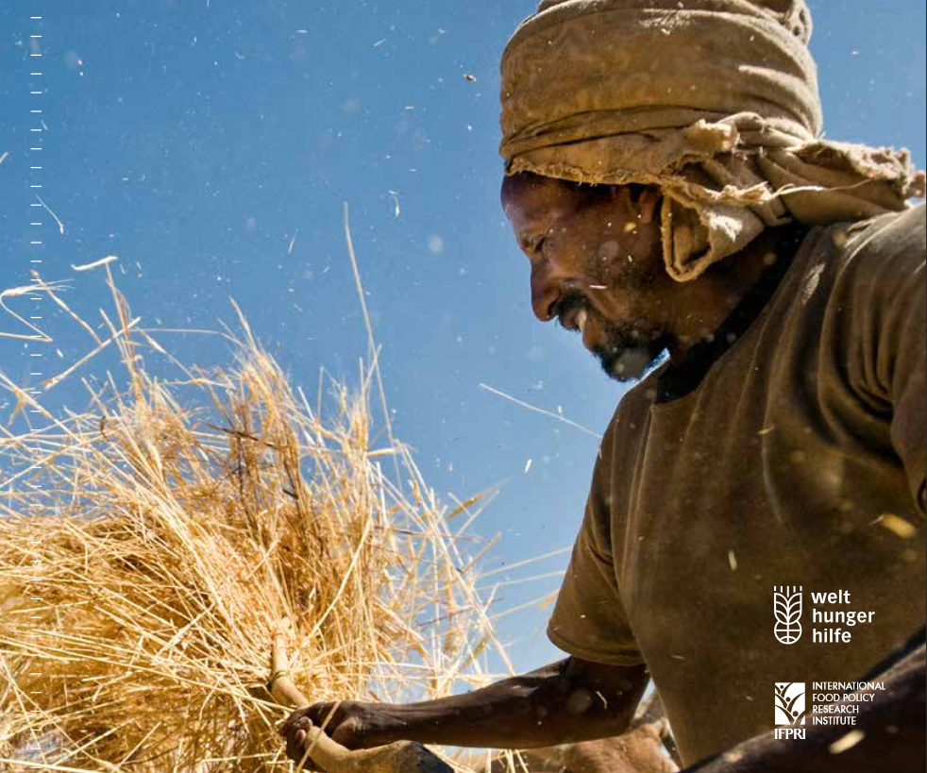
International Food Policy Research Institute (IFPRI)
Global Hunger Index (118 counties, high income nations ignored)
Undernourishment
Child mortality
Insufficient calorie
Child Wasting
Child stunting
Low height for age
Low weight for height
Acute undernourishment
Chronic undernourishment
<5 deaths
15% junta
~15%
~39%
~5%

Slide 16
Prelim 2016
77. Which of the following is/are the indicator/indicators used by IFPRI to compute the Global Hunger Index Report? 1. Undernourishment 2. Child stunting 3. Child mortality Select the correct answer using the code given below. (a) 1 only (b) 2 and 3 only (c) 1 , 2 and 3 (d) 1 and 3 only

Slide 17
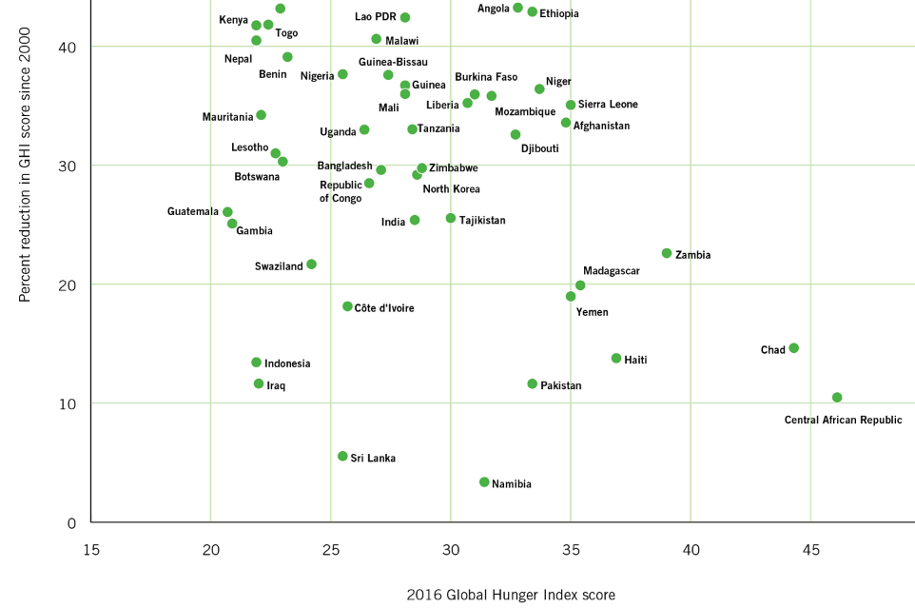
2016 Hunger report: theme “Getting to zero hunger (by 2030)”
97th out of 118 pathetic countries.
China, Brazil etc <10 score..
Most bogus nation in HDI & Happiness also

Slide 18
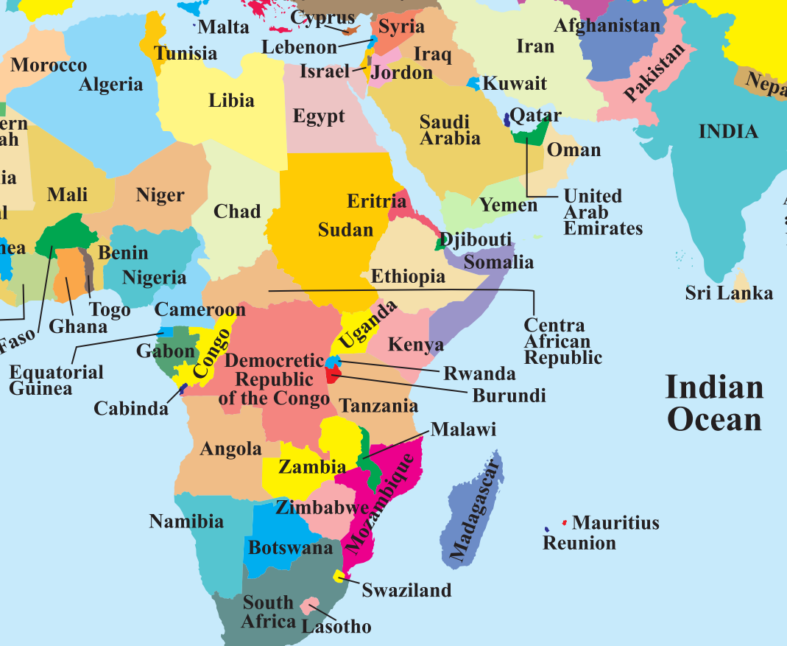
Marrakesh UNFCCC’16
Most bogus in
HDI-2015
BRICS’16 Summit @Benaulim, Goa
PBD17: Bangaluru
UNEP HQ & _’s Casino.
Capital Bangui
Central African Franc
Kigali’16
Tax Choro ka Swarg

Slide 19
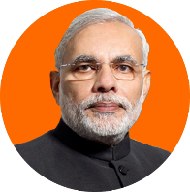
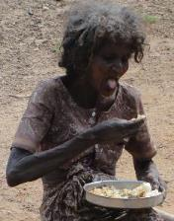
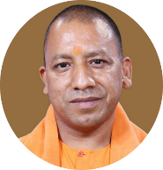
Hunger Index National Food security Act (NFSA) 2013
75% of rural
50% of urban junta covered
Cereal / Allowance
Procurement
Storage
Supply to States
Identify beneficiaries (SECC) & Distribute
32 State/UT implemented as of 2016
Gujarat in 2016, April
Chandigarh, Puducherry : DBT- buy from commercial market.
Total 67% Population covered
Cereal / Allowance
Shanta Kumar panel on food subsidy- cover only 40%, because ‘populism’, resources, even WTO “peace clause” <Mains>

Slide 20
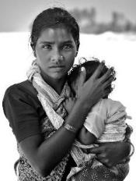
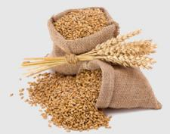
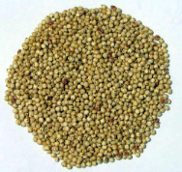
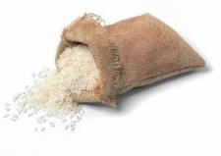
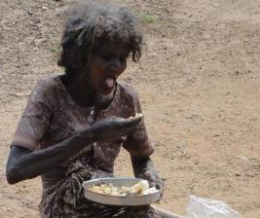
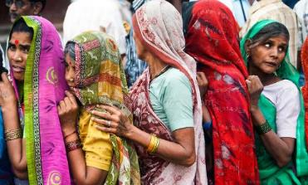
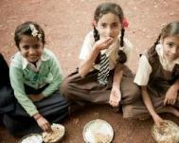
National Food security Act 2013
Rice Rs. 3/kg
Wheat Rs. 2/kg
Coarse grain 1/kg
Rs. 6000 (total)
+ food upto 6 months post delivery. PMMSY
Antyodaya Anna
35 kg / FAMILY / Month
Priority households
5 kg / PERSON / Month
Free meals & rations upto 14 years

Slide 21
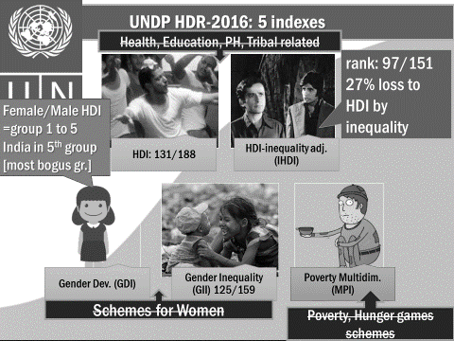
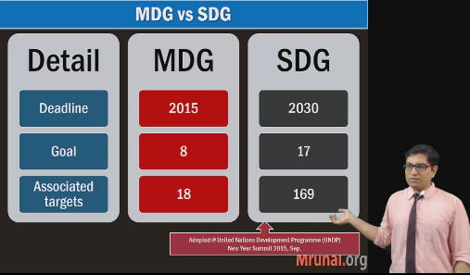
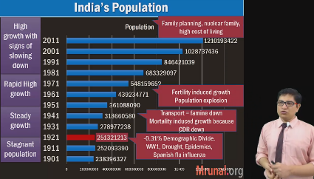
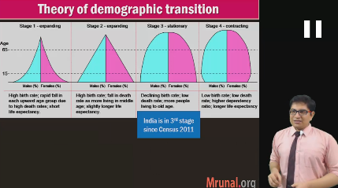
Self study BES166: SDG link <watch only last 10 minutes>
Next we’ll learn survey Ch.10 but pre-requisite is BES166: Census theory, population theory LINK

Slide 22
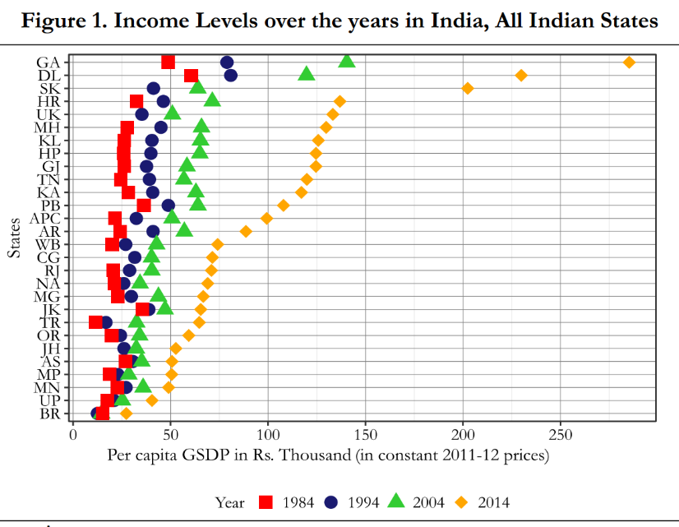
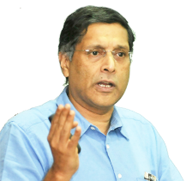
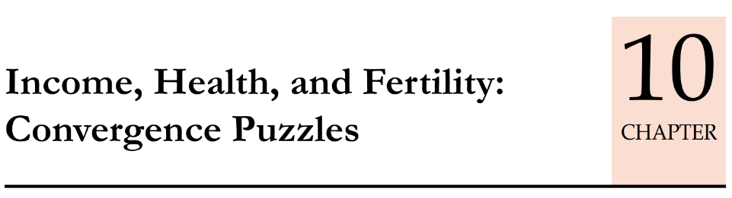
Prof Raj Krishna “theHindu Growth Rate” (‘78) = ~3.5% from 50s to 80s
Yes but we’ve moved beyond that. Even most backward states have grown!

Slide 23
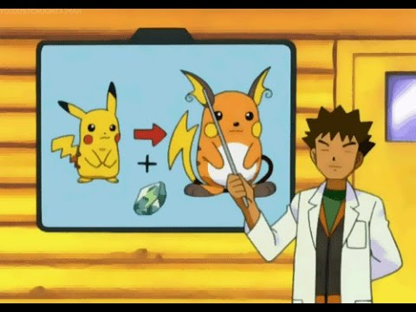
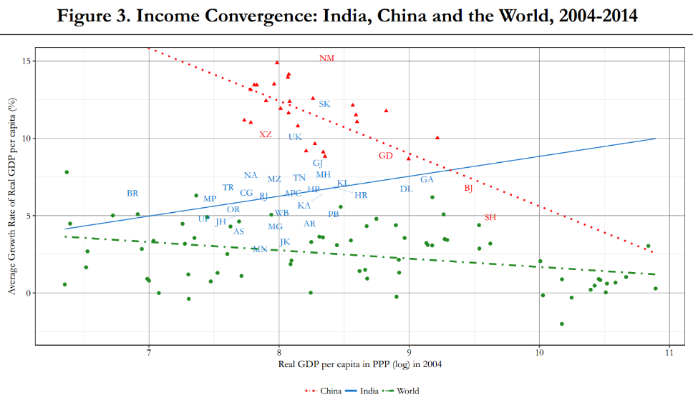
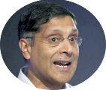
Convergence theory: the less developed a state is @ beginning, faster it’ll grow subsequently
Migration and Remittance
Migration to Coastal provinces
Remittance
Demand ▲ in poor province
Mfg activity, Productivity , Wages ▲
Dekho..Because of migration and remittances China’s interior provinces’ Pokemons evolved.
Only Indian interior states are like Pikachu that are not evolving into Raichu. <or very slowly evolving>
1) RRT Aid curse 2) Resource Curse. <REF lecture Ch.13 (BES172) >

Slide 24
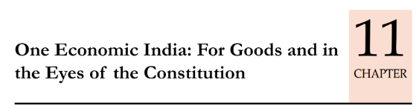
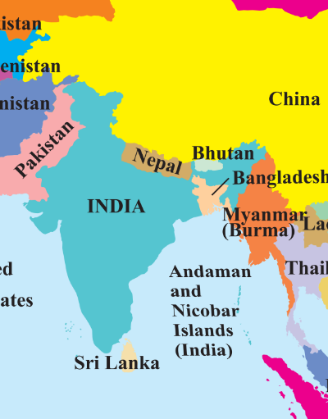
Internal trade is __ times the Foreign trade was not a “real growth” because if it was a real growth then Pokemon should have evolved.
Migration to Coastal provinces
Remittance
Demand in poor province
Productivity
Wages
1.6x
1.7x
Not “Genuine” growth in trade
CST/VAT
Hopefully GST will fix.. ☺
Excise: area based exemption
Governance issues ☹
Annual 1.5 lakh cr Internal Remittance yes but “Investment/capital” no ☹
“Brain drain” = productivity ☹
Service sector led growth = even high skilled entrepreneur can’t go back to low skill state ☹.

Slide 25
Mock Question for Prelims
According to the Economic Survey of India, our interior states are backward than our coastal states because:
Though, interior states’ male workers have migrated to coastal states, the amount of internal remittance is very meagre.
They trade very little with the coastal states.
Despite mineral wealth and finance commission grants, their governance structure is poor.
All of the above.

Slide 26
Convergence theory: less developed you are @ beginning, faster you’ll grow subsequently
Not Happening
INCOME (GSDP per capita) ▲
CONSUMPTION ▲
YES Happening
Life expectancy ▲
IMR (but still high), MMR ▼
TFR ▼
Because
Labour, capital mobility hampered.
Though competitive fed ☹ but poor governance traps.
Because
Free technology flow
For rich states, difficult to improve further. <NEXT SLIDE>

Slide 27
Convergence theory: less developed you are @ beginning, faster you’ll grow subsequently
102%
CAT score improvement
4%
102%
Literacy rate improvement
5.5%

Slide 28
Growth vs Fertility Convergence
Fertility rate
Live births per 1000 women in 15-49 age
Total fertility Rate (All India: 2.4; Kerala<2)
IF woman lived through that age group, how many babies?
Target: 2.1 (Replacement level)- she +her husband replaced
Extra 0.1 to compensate risk of unforeseen accident/deaths
Notes:
Total fertility rate
# of children born to a woman
The total fertility rate refers to the total number of live births that a hypothetical woman would have if she lived through the reproductive age group and had the average number of babies in each segment of this age group.

Slide 29
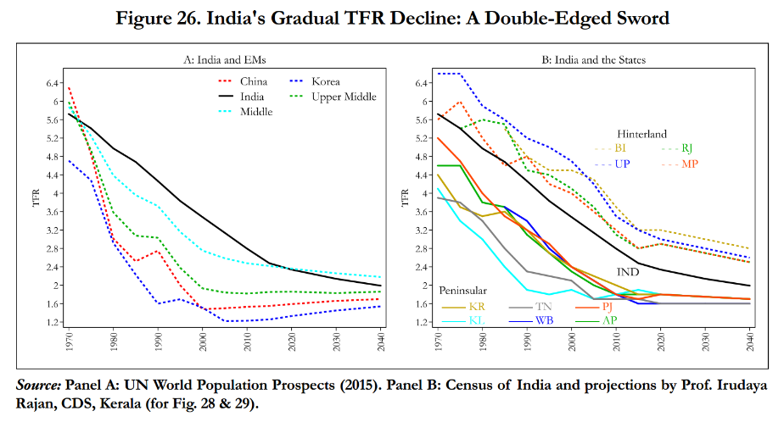
China TFR<2 = aging started from 2000s. Wages ▲
Coastal states <2 (Aging population)
Hinterland >2
Notes:
Older workers demand higher wages on account of family responsibilities.

Slide 30
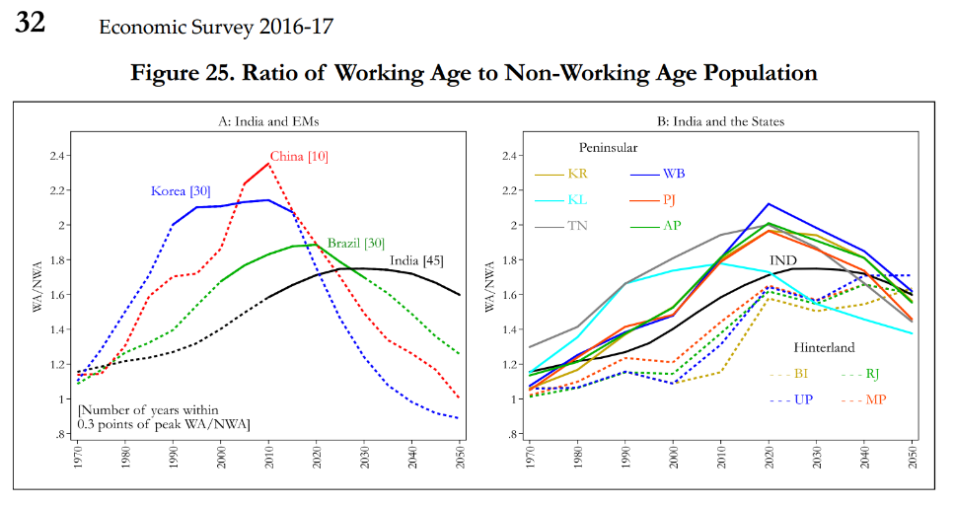
Same bolbachchan through graphs
China declining since 2010
India, will start to decline post-2020
$$Demographic Dividend:\frac{Working age Pop. }{Non Working Pop.}>1$$

Slide 31
Another way of looking at it
$$Demographic Dividend:\frac{Working age Pop. }{Non Working Pop.}>1$$
Younger population:
Productivity (GDP)
Tax Base, CSS, Fiscal Deficit
Entrepreneurship
Per capita income, Consumption
This will peak at
2020
For Coastal India (TFR<2)
2040
For Hinterland India (TFR>2)
Labour mobility from hinterland to costal states:
“RENT ▼” (demonetization long term benefit)
EPFO, factory labour law reforms
Textile, shoes industries to smaller towns: low rents

Slide 32


Economy: 6 pillars + theory + current + BES17 (pre cum Mains)
1.Banking, Fin, Insur.
6.HRD
2.Budget
3.BoP
4.Sectors
5.Infra
V1:c3,4
V1:c2,3, 6,9,11(GST),13
V1c:5
V1c:7(Textile),11(trade)
V1c:10
v1c:12, 14; Budget^Rail

Slide 33
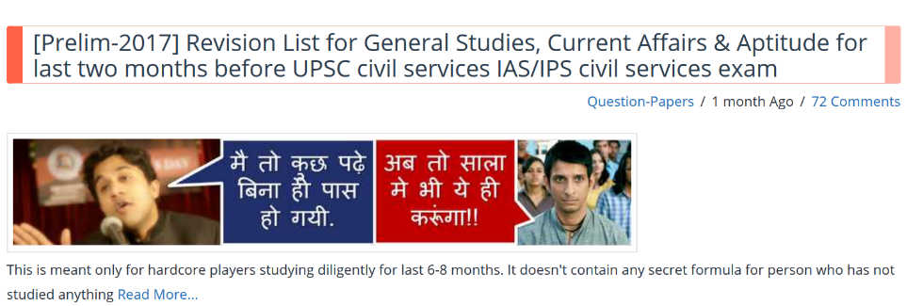
Revision plan / priority: already said in this article
If you’ve finished first to last PowerPoint = you’re serious about your career so irrespective of how many MCQs are asked this lecture series, you’ll succeed somewhere. Have faith in your self.
In retrospect: 1) some videos have poor audio quality 2) some have mistakes 3) I could have explained better or in more depth 4) I could have covered more topics….But अब भगवान मालिक है.(The Lord is my saviour and my judge.)

Slide 34
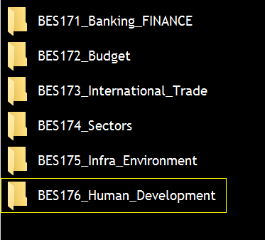
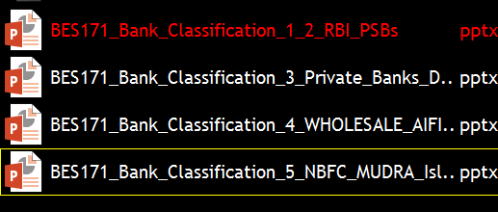
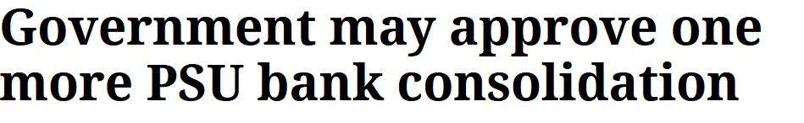
“BES17” Lecture series is over, “picture abhi..”
I’d recommend you to follow (atleast) Indian express for Economy related developments (if not reading theHindu).
IE: June 9, 2017. ball by ball. When done, just update the PPT in BES171
Because before “BES18” comes- there will be plenty of exams and interviews.
Ofcourse, current affairs magazine/PDF will cover it but If you don’t keep things ‘organized’ then revision will be tedious.

Slide 35
Road Ahead
Last one week- not much point in giving mocks 1) This is not CAT 2) if by giving mock, you get to know a disease’s fact#1, 2 while UPSC may ask but #3 and 4! So better do ‘entire topic’s revision’. + no point in waking whole night before exam.
@exam centre: Don’t be intimidated by “show-baaz” who gossip about “this topic will definitely come”, “ekdum lallu/easy paper, this time cutoff will be 150 marks!”.
@exam hall: Don’t be “hotel customer” in front of supervisor [e.g. my bench is too small, light is not coming, fan is not running, window is not open etc. i.e. in all the Eastern A’bad riot zones.] People have done it in past and failed for a simple reason- if you waste 15 minutes with supervisor, your own mental peace is disturbed so silly mistakes happen in ticking the GS’s OMR and Paper-II’s calculations / interpretations.
Out of 100 Qs, if one “random factoid” from your casual reading-asked, you think your ‘entire’ paper is gone well, and prelim- blame his failures on IIT/Engineers, UP,Bihari or Tamilians are taking away his job!! But instead you should do…

Slide 36
Post-Exam Analysis
Post exam-analysis: ‘cutoff’..x ; rather a) did questions came from what you had read? B) did you tick them correctly? update strategy accordingly.
If you’ve watched my ‘3 seasons on youtube’, then BES17: I’ve eliminated, and compressed many topics. Because, though I’m not appearing in exam, I do post-exam analysis for my own survival and success in ‘this line of work’.
So, if you’re giving this exam to get a Government job, you must do post-exam analysis of your own performance. Else by 3rd attempt you’ll have so much material, you can’t do focus on anything.

Slide 37
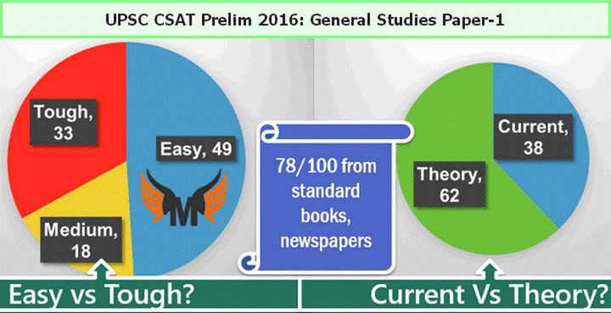
Prelim Sacred Cutoffs [After P2: 33%]: Gen|OBC >50%, others little <50%
Doing “De-thok” tukbaazi & law of avg. dangerous. UPSC 2016 is still relatively ‘easier’ by “elimination” method, but when examiner is in real back-breaking ™ …then
200
Prep+ Law of avg.
100
Else, why cutoff is lower? True little more vacancies, but still tougher paper than 16’s. So don’t go with ‘set’ mind, that I “MUST” TICK __ number of questions.
Paper-II also counted so total 400
Paper-II not counted so total 200

Slide 38
UPSC Prelims: Post exam analysis “unofficial score” [80-130]
But it doesn’t necessarily mean you’ll FAIL OR PASS. Because
Unofficial answer keys not 100% authentic. The more “quickly” released ones have more mistakes.
Most of the sincere students have in similar range of scores because used similar material and mind.
Trolls inflate their scores online to scare others.
Only few “Cinderella stories” clear entire exam cycle. You’ll have to give 2-3 attempts anyways. So don’t stop preparation.
“Digested” Bullet point material (PPT, PDF, Mindmap)= you’ll understand the topic but improve your expression and language skill. Mains-2016, many got good marks in GS [parallel to toppers] but poor in Essay and paper-1 of humanities optionals. So keep habit of reading ‘full-text’ english newspapers, columns, Yojana etc.

Slide 39
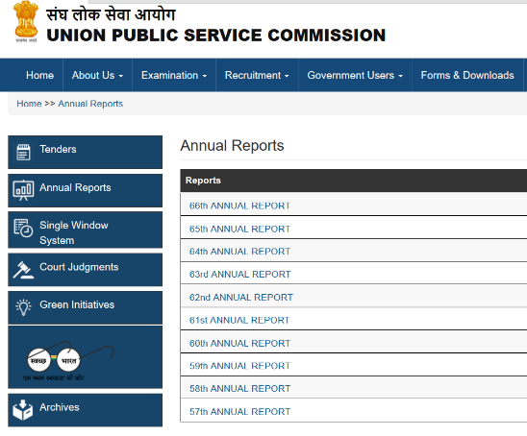
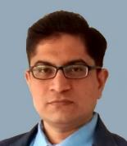
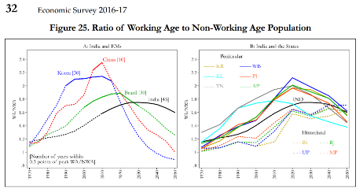

Slide 40
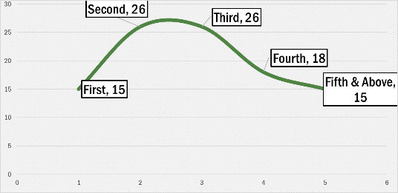
Success is bell shape curve: Final toppers in UPSC vs. “Attempt”
This is also like China’s demographic peak. Else you can give “n” number of attempts. But chances start to ▼.
If not achieved
Misdirected
Lazy, Daydreamer
Not ‘cutout’ for this
People can only
help you here
Your Objectives [if you’ve just started]?
Straight arrow
By 2nd “serious attempt”: Mains must be written/final selection.
By 3rd “serious attempt”: Officer Rank job UPSC, SSC, IBPS. >4+…if finance, family..
SSC, IBPS, GPSC….
And before you realize, your age-attempt over for all exams

Slide 41
Road ahead
UPSC fail, some other exam: look at syllabus, old papers & prepare accordingly. If you arrogantly think “[GS+aptitude] is there and I missed prelims cutoff by just 1 mark” and you keep reading same things, then you’ll fail in others exams. [CAPF, SSC, State PCS, IBPS, RBI- each have their peculiar syllabus, difficulty & senior players].
Most importantly: don’t just sit for 3-4 years with blank biodata. Atleast do some distance-mode PG / certification course from IGNOU, Ambedkar uni. etc. just for the sake of showing in interview panel / career backup.
Best wishes to all serious players
for all the competitive exams

